Slide 1
Crowdcount : People Counting and Zone Management System
Presented By: Patel Dhruvil H.
Mentor: Umme Asma s.
Batch: C
Training Duration: 22/09/2025 – 21/11/2025

Slide 2


Project Introduction:
Public spaces like malls, airports, and parks often require real-time people counting for
security, analytics, and operational efficiency. This project aims to automate people
counting using a live camera feed, leveraging computer vision and deep learning. The
system will detect and count people in a video stream with high accuracy and provide
live analytics through an interactive dashboard. It will support multiple zones and
ensure smooth performance with real-time processing.

Slide 3

The Challenge: Bridging the Gap in Crowd Monitoring
Public spaces are dynamic ecosystems where crowd behavior directly impacts safety and management. Traditional, manual counting methods are inherently inaccurate, labor-intensive, and incapable of providing real-time data needed for effective response. This project tackles these limitations head-on by aiming to:
High-Accuracy Detection
Precisely identify and count people, minimizing errors inherent in human observation.
Real-Time Analytics
Deliver instantaneous insights into crowd density and movement.
Multi-Zone Capability
Monitor multiple distinct areas simultaneously for comprehensive oversight.
Efficient Processing
Ensure low-latency data processing for immediate action.

Slide 4
Key Objectives: Building a Robust Solution
Our project is structured around clear objectives designed to deliver a comprehensive and effective crowd management system:
1
2
3
Automated Real-Time People Counting
Accurate Deep Learning Detection
Interactive Live Analytics Dashboard
Develop a system for continuous, automated people counting from live camera feeds.
Implement YOLOv8 (You Only Look Once) for precise individual detection and tracking.
Provide a user-friendly dashboard for visualizing real-time crowd data and trends.
4
5
Multi-Zone Occupancy & Alerts
Low-Latency & Secure Access
Track occupancy across various zones and trigger automated alerts based on predefined thresholds.
Ensure rapid data processing and secure, user-friendly access to the system.

Slide 5






Technology Stack: Powering the System
A diverse set of cutting-edge tools and libraries forms the backbone of our People Counting and Zone Management System, ensuring robustness, scalability, and efficiency.
Programming Core
Computer Vision & AI
Python, Flask, HTML, CSS, JavaScript: The primary languages and framework for backend logic, web development, and interactive front-end experiences.
OpenCV, YOLOv8, NumPy: Essential for real-time video processing, object detection, and numerical operations crucial for crowd analysis.
Data Management
Data Visualization
MySQL, Pandas: Robust databases for storing system configurations and analytics data, complemented by Pandas for data manipulation.
Chart.js : Powerful libraries for creating dynamic, interactive charts and graphs to visualize crowd analytics.
Development Environment
Security Protocols
VS Code: Our integrated development environment, providing a rich feature set for efficient coding and debugging.
JWT Authentication: Implementing JSON Web Tokens for secure and stateless user authentication, safeguarding access to the system.

Slide 6

Milestone 1: Establishing the Foundation
The initial phase focused on building the core user authentication and system interface, creating a secure and accessible platform for subsequent developments.
User Authentication
Implemented Login and Registration functionalities, ensuring secure access.
JWT Security
Integrated JSON Web Token (JWT) for robust and stateless user authentication, enhancing system security.
Flask & Database Integration
Developed the UI using a Flask backend seamlessly connected to a chosen database.
Intuitive Navigation
Designed a clear sidebar navigation including Home, Profile, and Logout options for easy user experience.

Slide 7
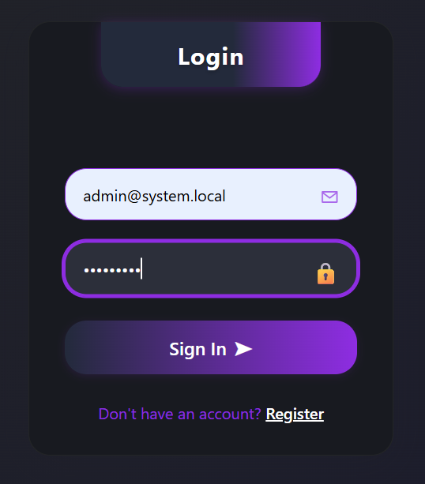
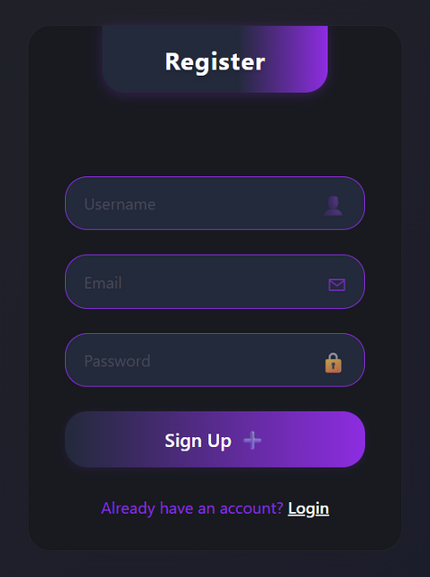

Milestone 1:

Slide 8



Milestone 2: Vision and Detection Capabilities
This milestone brought the core computer vision capabilities online, enabling the system to detect and track individuals through various input modes, a crucial step for accurate crowd monitoring.
YOLOv8 Integration
Successfully integrated YOLOv8 with OpenCV for real-time object detection, forming the intelligence of the system.
Flexible Input Modes
Configured support for Live Webcam, Image Upload, and Video Upload, catering to diverse deployment scenarios.
Visual Detection
The system now accurately displays detected people with bounding boxes, providing visual confirmation of recognition.

Slide 9
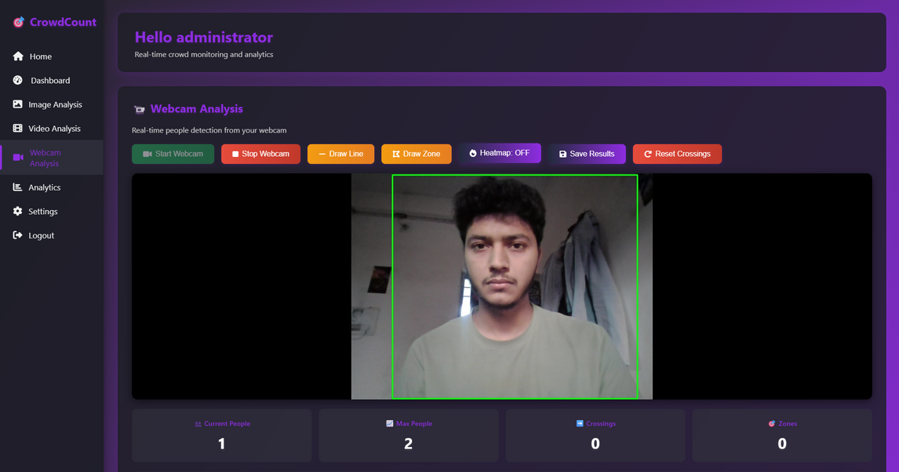
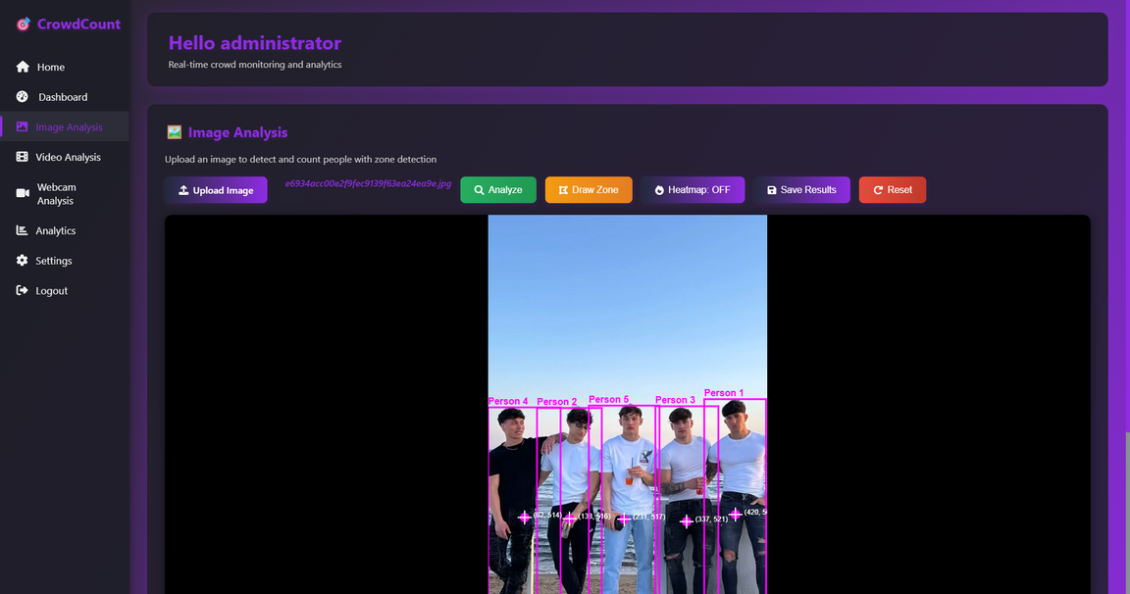
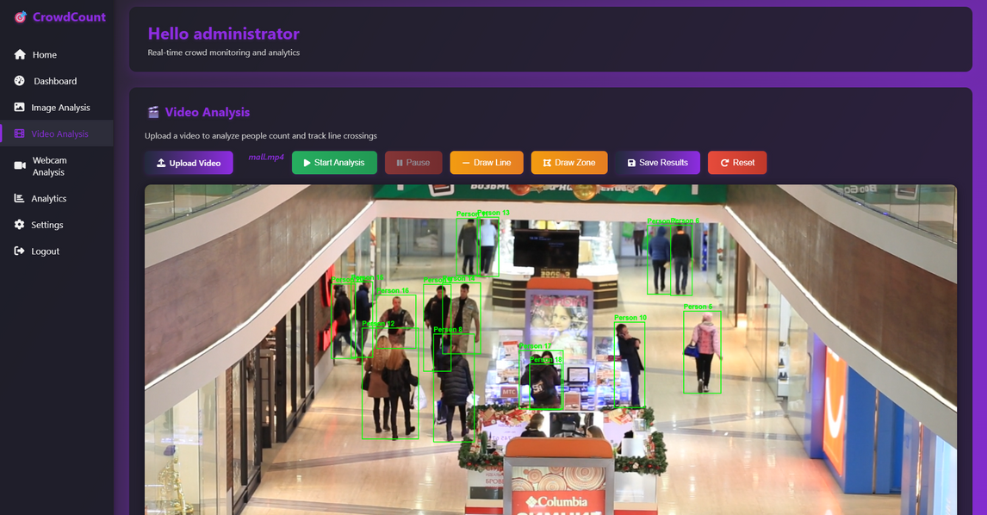
Milestone 2:

Slide 10
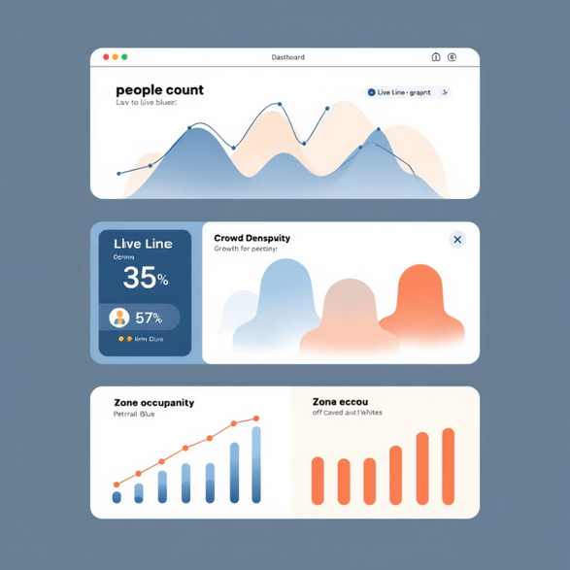
Milestone 3: Dynamic Live Analytics Dashboard
The focus of this milestone was to transform raw detection data into meaningful, visual insights through a sophisticated and responsive analytics dashboard, enabling proactive crowd management.
Real-time Data Visualization
Implemented a Live Analytics Dashboard displaying crucial crowd metrics as they happen.
Trend Analysis
Incorporated a line plot to track people count over time, identifying patterns and fluctuations.
Zone Occupancy
Showcased Daily Detection summary through an interactive bar plot, offering quick spatial insights.
Automated Notifications
Enabled automatic normal/alert notifications based on predefined thresholds for proactive intervention.

Slide 11
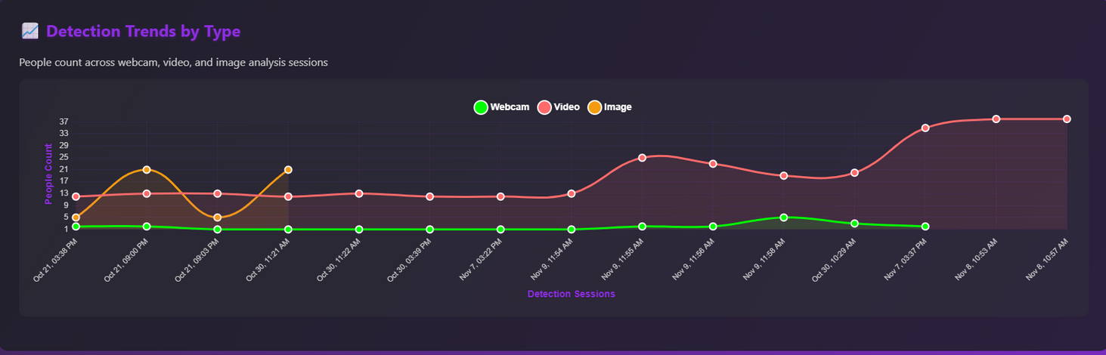
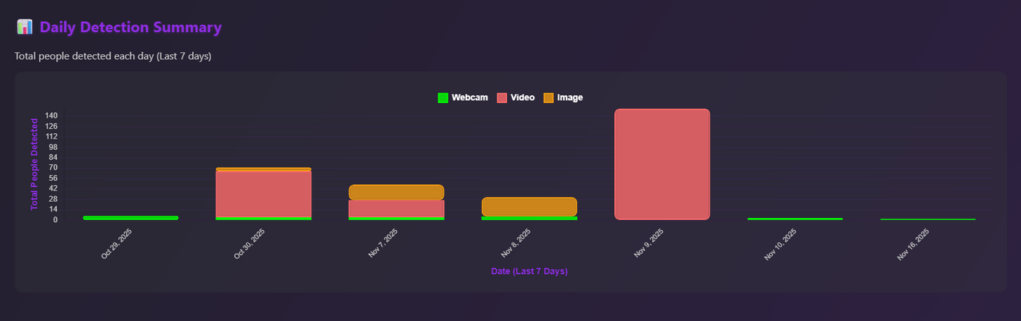
Milestone 3:

Slide 12

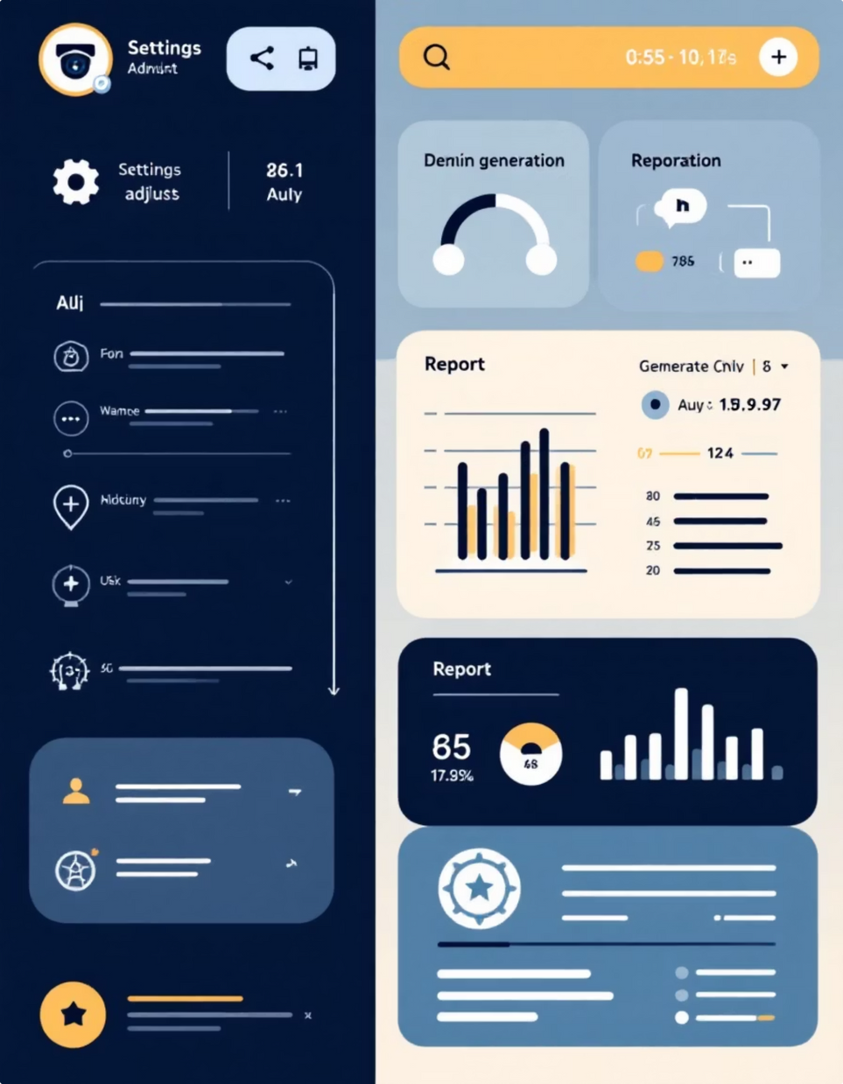
Milestone 4: Comprehensive System Control & Reporting
The final milestone adds critical administrative features, enabling full control over the system, robust reporting capabilities, and secure access management, making the system enterprise-ready.
Admin Camera Management
Introduced administrative controls for efficient management and configuration of all connected cameras.
Downloadable Reports
Enabled the generation and download of comprehensive system reports for historical analysis and compliance.
Role-Based Access
Implemented secure role-based access, ensuring that users only interact with functionalities relevant to their permissions.
Complete Analytics & Logging
Provided extensive logging and analytics support, offering deeper insights into system performance and crowd behavior over time.

Slide 13
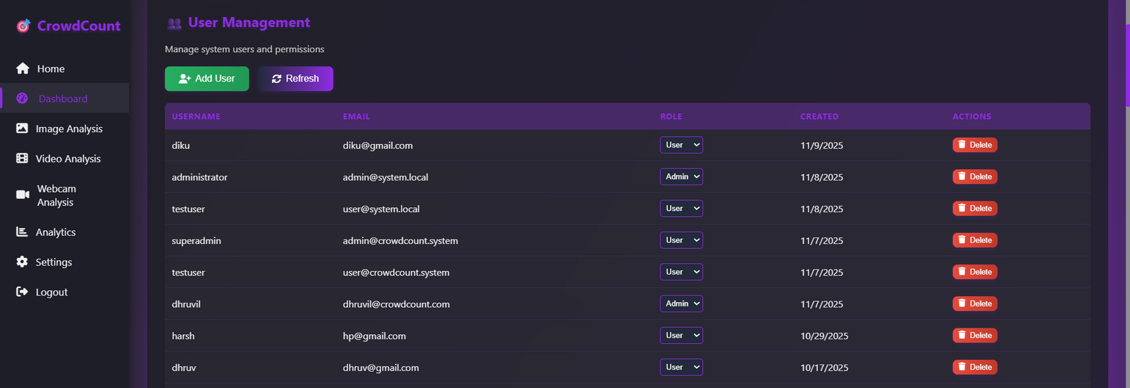
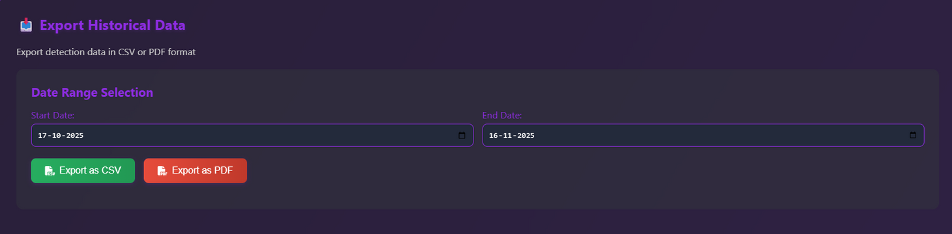
Milestone 4:

Slide 14


Conclusion: Intelligent Crowd Monitoring for the Future
The People Counting and Zone Management System represents a significant leap forward in automated public space monitoring. By harnessing the power of computer vision and deep learning, it delivers an unparalleled level of accuracy and efficiency.
Enhanced Security
Real-time insights empower rapid response to crowd anomalies and potential security threats.
Optimized Operations
Data-driven decisions lead to improved resource allocation and operational efficiency in various environments.
Scalable & Adaptable
Designed for deployment in diverse public environments, from airports and malls to parks and event venues.
Future-Proof Solution
A robust foundation for future enhancements and integrations, ensuring long-term applicability.
This system is ready to revolutionize how we manage and understand crowd dynamics, contributing to safer, smarter, and more efficient public spaces.

Slide 15
Thank You

